Slide 1
Movie Recommendation System
FRE 7773 Machine Learning in Finance
Group LearningMachine
PRESENTED BY Shawn Yin
12/10/2021

Slide 2
What is a Recommendation System
01.
Recommendation System Overview

Slide 3
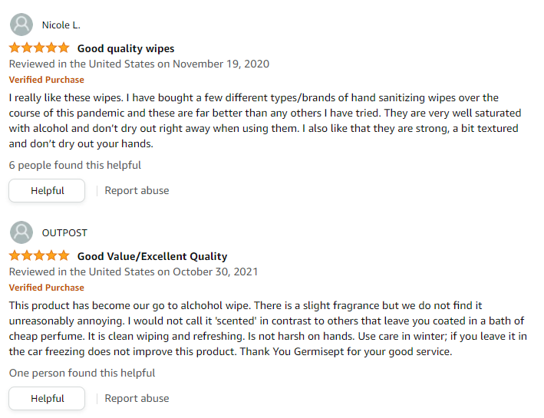


Why this topic?
Movie Recommendation System
Bank Customer Churn Prediction
Shopping Comment Clustering

Slide 4
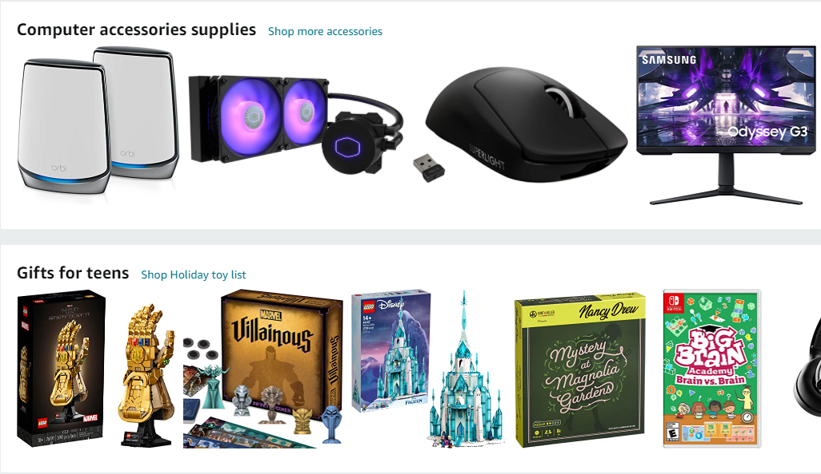
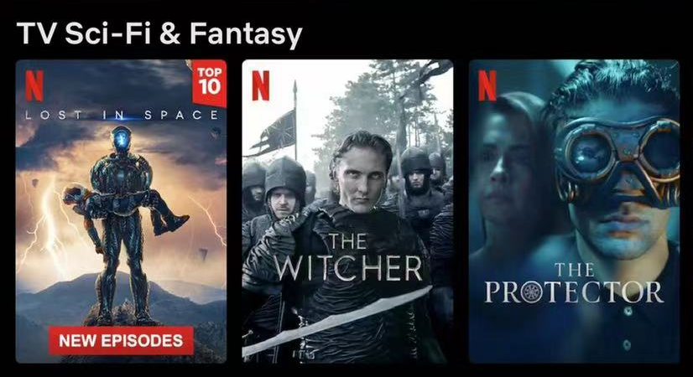
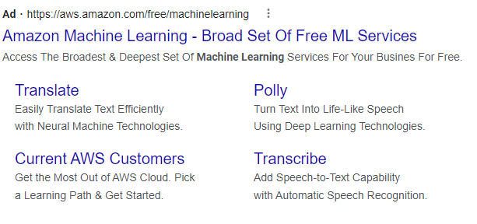
Use Cases
E-Commerce
Recommend similar items based on your shopping history
Video
Recommend tv show / movies based on watching history
Advertisement
Personalized Ads

Slide 5
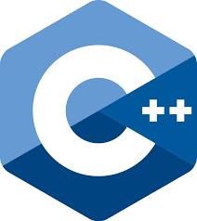


Recommendation System is an idea
Recommendation system is an idea, it is not constratined by programming language.
Understanding the framework and pipline of building a recommendation system helps us to be prepared for more opportunities.

Slide 6
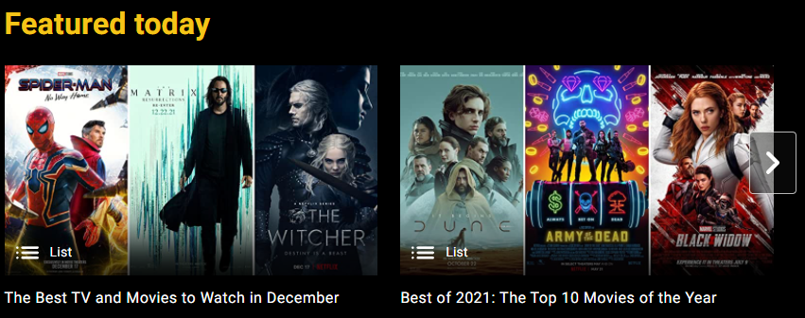
Why Movie
Movie recommendation system is relatively easy, because what we care about is user and their ratings to movies which makes the features matrix easier to handle.

Slide 7
Common Methodology
02.
Different Approaches

Slide 8
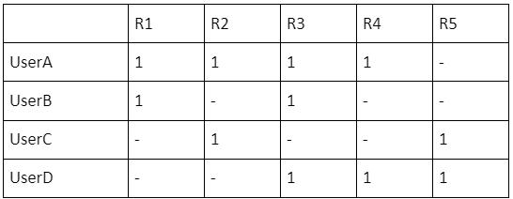
Problem we want to solve
In one Sentence:
Find the missing value for the ratings matrix
In detail:
We know the history rating of an user to movies, and we want to compute reasonable rating predictions for this user to other movies that he/she never rated before.

Slide 9
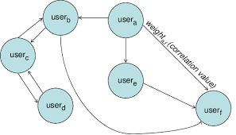
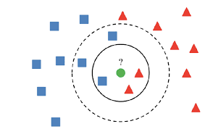
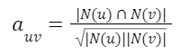
Method 1: User-based Method
Key Assumption:
If someone has similar profile with you, probably you will like what he/she likes.
Math: how to define similarity?
Cosine Similarity:
Algorithm:
K Nearest Neighbors (KNN) → weighted rating → output

Slide 10
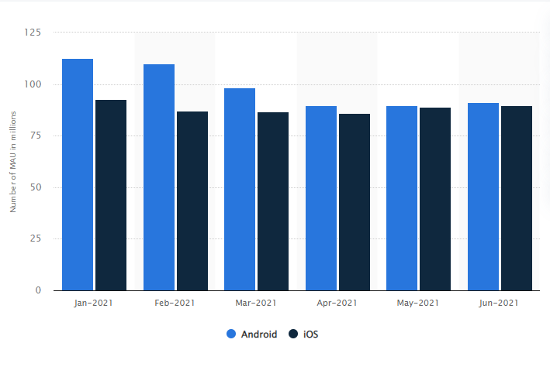
What is the problem of user-based method?
Storage:
To use this algorithm online, we need to precompute a user similarity matrix. Suppose we have n users, and the matrix will have n^2 numbers.
For example, NETFLIX has MAU of approximately 200 million on mobile platform (including IOS and Android) so if use this method, the cost of storage is huge.
https://www.statista.com/statistics/1251899/netflix-app-monthly-active-users-worldwide/

Slide 11
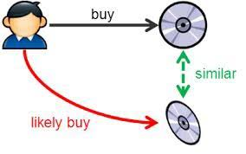
Method 2: Item-based Method
Key Assumption:
If you like an item, you probabliy like the items that are similar to this item.
Math: how to define similarity?
Cosine Similarity:
Improvement:
Item-IUF (Inverse User Frequence): we assume that non-active user has lower influence on rating, so we add a regularization when computing cosine similartity.

Slide 12
User-based vs Item-based
User-based method reflects how the society reacts to products. Because you are finding similar people in the society and combine their opinions to make recommendation.
Use case:
Great for situation that item updates more frequently than user.
For exmaple, news app
Item-based method reflects how the user itrself reacts to products. Because you are finding similar items based on your own history.
Use case:
Great for situation that item less likely to be changed.
For exmaple, e-commerce and bookstore system

Slide 13
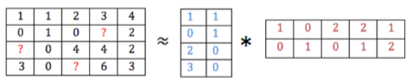
Method 3: Matrix-based Method
Basic Idea:
The target matrix can be computed by two hidden matrix.
You can assume each user can be described by k attributes like movie topics in movie system.
Then each movie can also be described by k attributes.
If we can get these two matirx, we can get all missing values.
Algorithm:
Matrix Factorization and this is what we choose for this project.

Slide 14
Cold Start Problem
03.
How to Solve

Slide 15
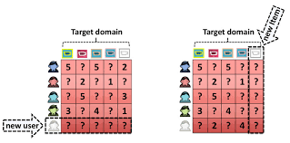
What is cold start
Cold start concerns the issue that the system cannot draw any inferences for users or items about which it has not yet gathered sufficient information.
For example:
Suppose a user that is not in the dataset. We can observe that this row is null and we know nothing about this user. Based linear algebra, there is no way we can generate ratings for this new user.
Suppose an item that is not in the dataset, it will added as a column and we also cannot predict anything for that.

Slide 16
For new item
Strategy:
No prediction. We tell the user that this item is not in database and we can do nothing.
Why:
First, for a user who use the system, what will he/she input? Movie Title!
Can we just use the movie title without any other information to find similar movie? NO!

Slide 17
For new user
Thought 1:
We gather basic demographical info of user and use an KNN to find similar use and output weighted recommendation?
Can it work? NO!
User profile data especially those demographical information are highly private and no way to get the dataset.
Thought 2:
Output the top viewed movies.
Can it work? YES!
Pandas can do that!

Slide 18
Dataset
04.
Source and EDA

Slide 19
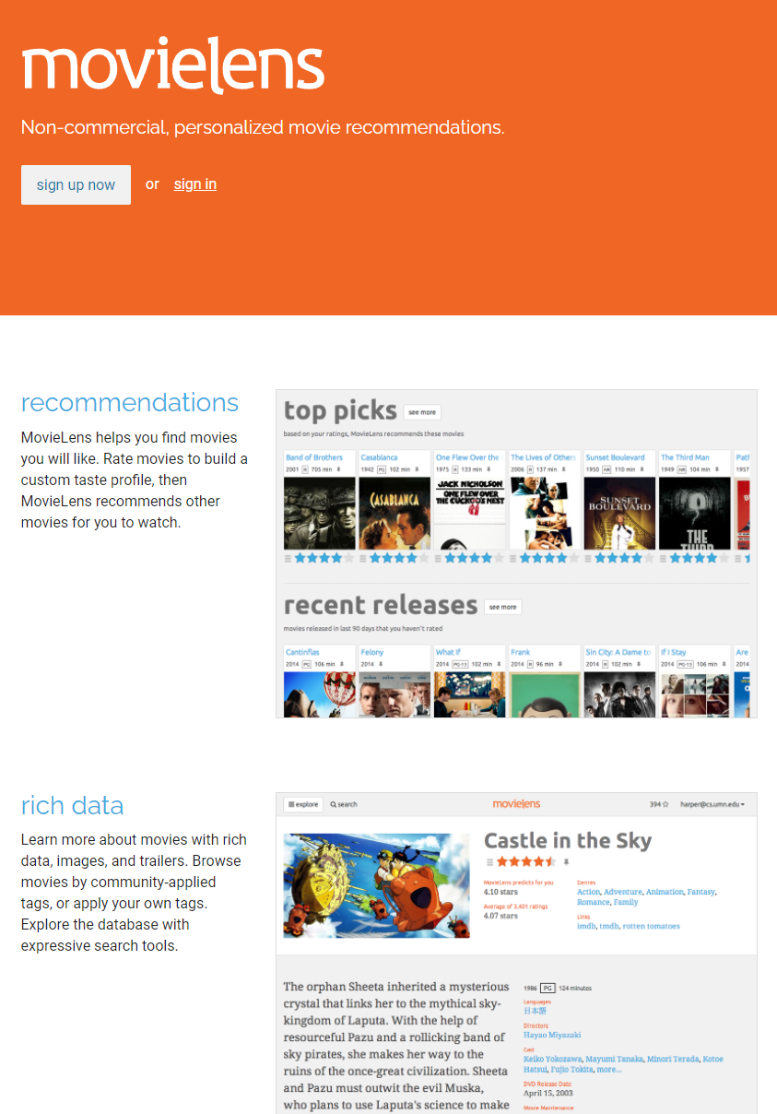
Movielens Dataset
About Movielens:
MovieLens is a web-based recommender system and virtual community that recommends movies for its users to watch, based on their film preferences using collaborative filtering of members' movie ratings and movie reviews.
Dataset Source:
https://grouplens.org/datasets/movielens/latest/

Slide 20
EDA
Package we used:
We use PySpark to do the EDA because the dataset is a relational dataset and is perfectly operated by SparkSQL.
What we did: Check GitHub for code!
General info: there are 610 users and 9742 movies in the dataset.
Rating info: 9724 movies have been ratedm and 18 movies have not been rated. The majority of ratings are around 4.0 and it is a left skewed distribution.
Top 100 movies: we generate top 100 viewed movies and top 100 rated movies.
Genres: there are 19 genres in total. The top 3 genres including most movies are Drama, Comdey, and Thriller.

Slide 21
Model
05.
ALS and SVD

Slide 22
PySpark and ALS
What is ALS:
Alternating Least Square (ALS) is a matrix factorization algorithm.
Pipline:
Data load: we initlize Spark and load csv files with Spark API.
Data preprocessing: drop timestamp column which is not useful in this project; convert user id, movie id to int, and raing to float.
Train test split: use the Spark built in method randomSplit to split given ration 8:2
Tune and Cross Validation: we build a grid search to tune four hyperparameters and use a 4 fold cross validation to do model selection.
Testing: we use the RMSE as the metric and got 0.886 and write two functions to generate recommendations.

Slide 23
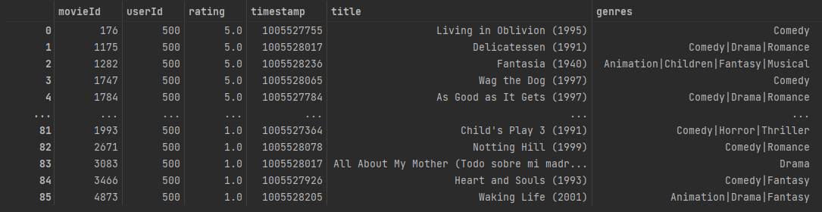
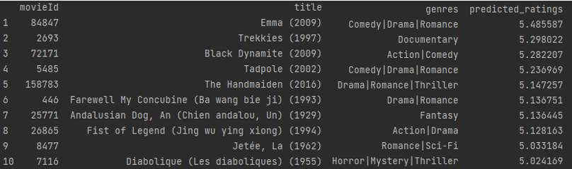
PySpark and ALS
Qualitative Check for user: if the user in database
Firstly, we pick user id 500 as the test case, and we first get his/her history top rating movies:
We can observe that this user likes Comedy, Drama, Animation movies.
So what will the recommendation be?
We can see that the recommendation offers mostly Comedy, Drama movies, which is correct with the genre this user likes.

Slide 24
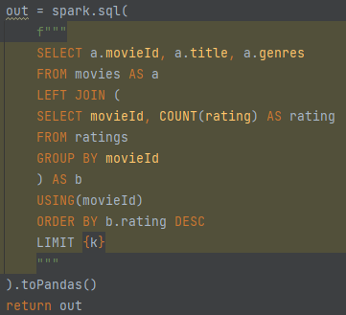
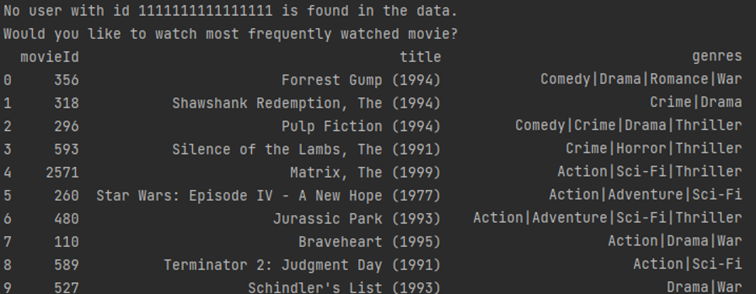
PySpark and ALS
Qualitative Check for user: if the user not in database
For this situatuin, we firstly use SparkSQL to generate a top viewed table
Based on this SQL, we get the top k viewed movie and if the user id is not in the dataset, we return this table, and the result for 10 is:

Slide 25
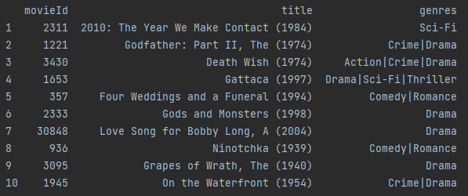
PySpark and ALS
Qualitative Check for item:
We choose movie id 858 which is the move “The Godfater” and lets see the top 10 similar movie we get:
We can see that The Godfather Part II in the output! Which means it is a reasonable recommendation!

Slide 26
PySpark and ALS
Seems everything is alright? NO!
The problem happened when we try to convert code into MetaFlow.
Locate Problem:
The error says that “cannot pickle variable xxx”. That is for a line where I called Spark and build ALS model and let a field reference to the model.
Our Analysis:
We first google it and found it is something related to broadcast variable which we have no idea what that is.
Then we notice the “pickle” in the error message. We know that is a package to save python object with serialization. So we went to check whether PySpark can use pickle.
We check the Spark Java Source code and its doc, and we found that all model in PySpark implements the Saveable interface so that it cannot use pickle for storage.
Combining those information, we think that in metaflow, serialization happens when creaing field and objects and since PySpark cannot use this method for serialization, it cannot work with MetaFlow.

Slide 27
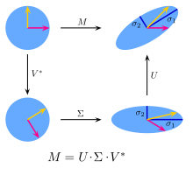
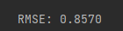
Surprise and SVD
What is SVD:
In linear algebra, the singular value decomposition (SVD) is a factorization of a real or complex matrix.
Pipline:
Data load: use pandas to load data, and use surprise Dataset to store data for model training.
Data preprocessing: drop timestamp column; convert user id, movie id to int, and raing to float.
Train test split: use the surprise built in method train_test_split to split given ration 8:2
Tune and Cross Validation: we build a grid search to tune four hyperparameters and use a 5 fold cross validation to do model selection and use RMSE as evaluator.
Testing: we use the RMSE as the metric and got 0.857 and write two functions to generate recommendations.

Slide 28
Deployment
06.
Flask and AWS

Slide 29
Flask Deployment
Problem we met:
Unlike other project that may return a number or string, our recommendation is a table. How to solve that?
What we think:
From user’s perspective, is all information needed?
The answer is no, user does not care about the movie id, does not care about what genres it is, just give them the name!
For example, in NETFLIX app, what we see is the post of movie and its name.
So, what we did is to remove unnecessary data, and convert the table into a string and output the title string.

Slide 30
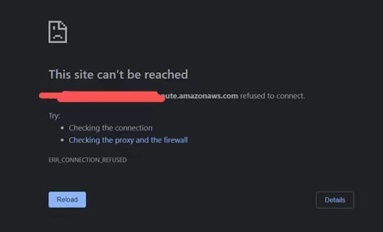
AWS Deployment
What we have done:
We created the EC2 instance
Generate the pair key
Successfully connect via WinSCP
Transported needed file to virtual machine
Launched the shell terminal
But we got refused when access by DNS
WE HAVE NO IDEA BASED ON OUR POOR NETWORK KNOWLEDGE!
WE WILL MAKE THIS OUR FUTURE WORK!

Slide 31
Show the Work

Slide 32
Thanks For Listening!!

